Slide 1
CSE 152: Introduction to Computer Vision
Credit: CSCI 143 from Brown by James Tompkin

Slide 2
Have you ever used computer vision?
How? Where?
Think-Pair-Share
Notes:
So, to begin, let’s conduct a little exercise. In the broadest sense, have you ever used computer vision? How? Where?
We’ll run a little ‘think-pair-share’ – for those of you unfamiliar, we think individually about the problem for a minute, then we will pair with a partner sitting next to you in the room to discuss it for another minute, then we will share our thoughts in the class.
Now, to help frame your thoughts, I’m going to introduce an idea.

Slide 3

Jitendra Malik, UC Berkeley
Three ‘R’s of Computer Vision
Notes:
Jitendra Malik – pioneer of computer vision (?)
Tried to coin a ‘Three R’s’ for computer vision. Instead of ‘reading, writing, and arithmetic’….
“For example, in the recent PASCAL benchmark challenge on visual object detection, the average precision for most 3D object categories was under 50%.”

Slide 4
Jitendra Malik, UC Berkeley
Three ‘R’s of Computer Vision
“The classic problems of computational vision:
reconstruction
recognition
(re)organization.”
Notes:
Jitendra Malik – pioneer of computer vision (?)
Tried to coin a ‘Three R’s’ for computer vision. Instead of ‘reading, writing, and arithmetic’….
“For example, in the recent PASCAL benchmark challenge on visual object detection, the average precision for most 3D object categories was under 50%.”

Slide 5
Have you ever used computer vision?
How? Where?
Reconstruction? Recognition? (Re)organization?
Think-Pair-Share
Notes:
So, let’s think about this question individually for a minute.
Now, in pairs, and that means potentially turning around in your seat, greet your neighbor, and please discuss your thoughts.
Board exercise: canvass the room. Write everything on the board that they come up with; put it into three R categories (many are in multiple).
Call up help from a TA to write on the board.

Slide 6
Laptop: Biometrics auto-login (face recognition, 3D), OCR
Smartphones: QR codes, computational photography (Android Lens Blur, iPhone Portrait Mode), panorama construction (Google Photo Spheres), face detection, expression detection (smile), Snapchat filters (face tracking), Google Tango (3D reconstruction),
Web: Image search, Google photos (face recognition, object recognition, scene recognition, geolocalization from vision), Facebook (image captioning), Google maps aerial imaging (image stitching), YouTube (content categorization)
VR/AR: outside-in tracking (HTC VIVE), inside out tracking (simultaneous localization and mapping, HoloLens)
Xbox: Kinect, full body tracking of skeleton, gesture recognition, virtual try-on
Medical imaging: CAT / MRI reconstruction, assisted diagnosis, automatic pathology, connectomics, endoscopic surgery
Industry: vision-based robotics (marker-based), machine-assisted router (jig), automated post, ANPR (number plates), surveillance, drones, shopping
Transportation: assisted driving (everything), face tracking/iris dilation for drunkeness, drowsiness, automated distribution (all modes)
Media: Visual effects for film, TV (reconstruction), virtual sports replay (reconstruction), semantics-based auto edits (reconstruction, recognition)
Notes:
James made a 10-minute list of all the existing applications that he could think of which used computer vision.

Slide 7
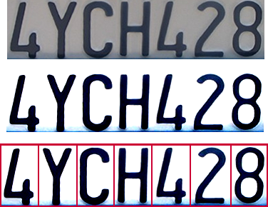

Optical character recognition (OCR)
Technology to convert scanned docs to text
If you have a scanner, it probably came with OCR software
Digit recognition, AT&T labs
http://www.research.att.com/~yann/
License plate readers
http://en.wikipedia.org/wiki/Automatic_number_plate_recognition
JH
Notes:
If you see a little ‘JH’ in the corner of the slides, then it means it was taken piecemeal from James Hays’ old class. Thank you to him and his course staff, over many years.

Slide 8
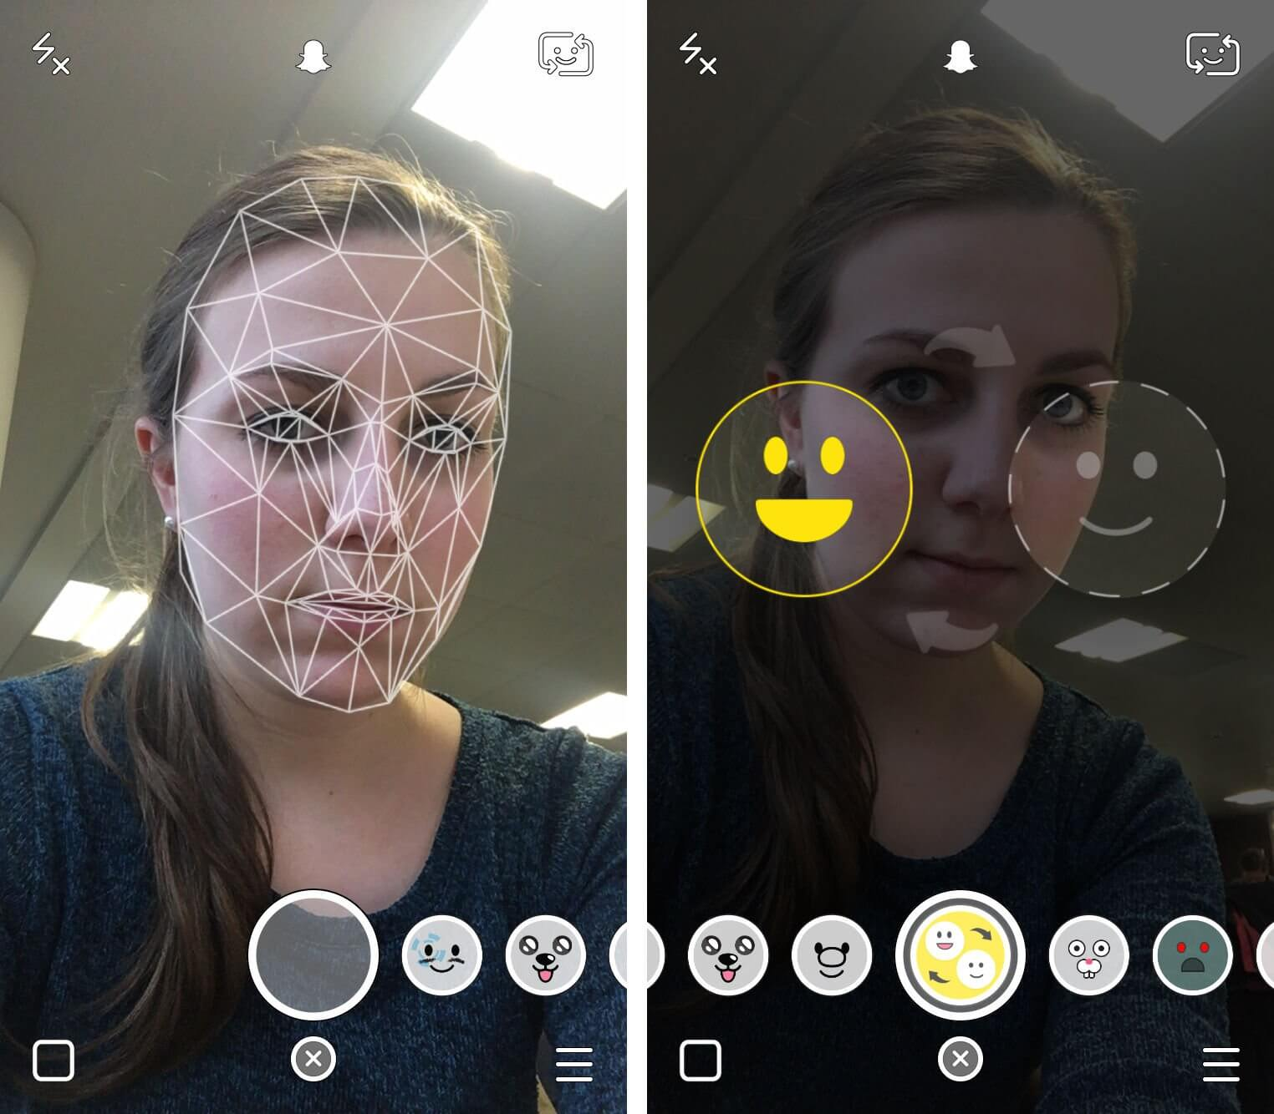
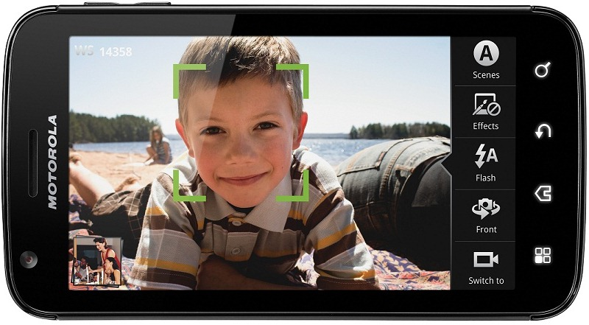
Face detection
Almost all digital cameras detect faces
Snapchat face filters
Notes:
https://www.google.com/url?sa=i&rct=j&q=&esrc=s&source=images&cd=&cad=rja&uact=8&ved=0ahUKEwjPu6nd1N3RAhVK7iYKHWSoDyAQjRwIBw&url=http%3A%2F%2Fforum.xda-developers.com%2Fshowthread.php%3Ft%3D1469709&bvm=bv.145063293,d.eWE&psig=AFQjCNEE8xqcq-R_KwPK2wc0Myo9pkI5Sg&ust=1485446226449425
Why would this be useful? Main reason is focus. Also enables “smart” cropping.

Slide 9

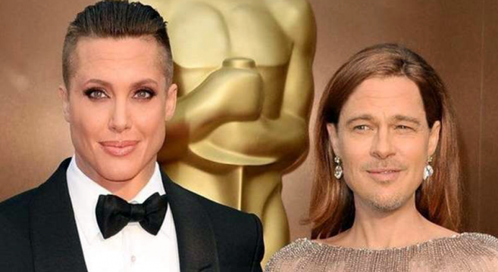
Notes:
Snapchat
Photo - http://thetechjournal.com/how-to/tutorial-face-swap-snapchat.xhtml
http://www.pleated-jeans.com/2016/03/02/21-snapchat-face-swaps-that-went-horribly-wrong/

Slide 10

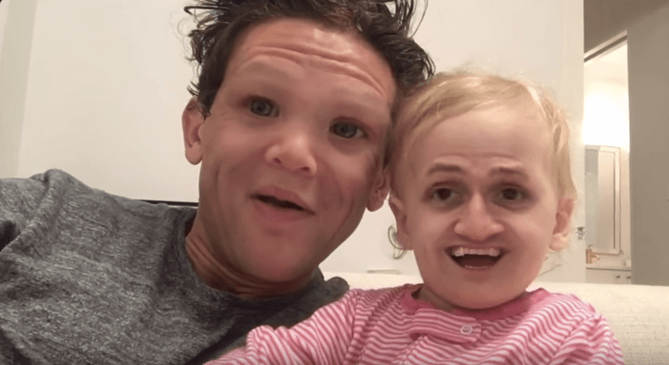
Notes:
Image - http://www.pleated-jeans.com/2016/03/02/21-snapchat-face-swaps-that-went-horribly-wrong/
What went wrong here?

Slide 11
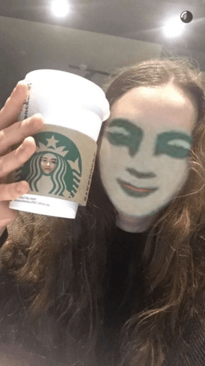
Notes:
Image - http://www.pleated-jeans.com/2016/03/02/21-snapchat-face-swaps-that-went-horribly-wrong/
What went wrong here?

Slide 12
Smile detection
Sony Cyber-shot® T70 Digital Still Camera
JH

Slide 13
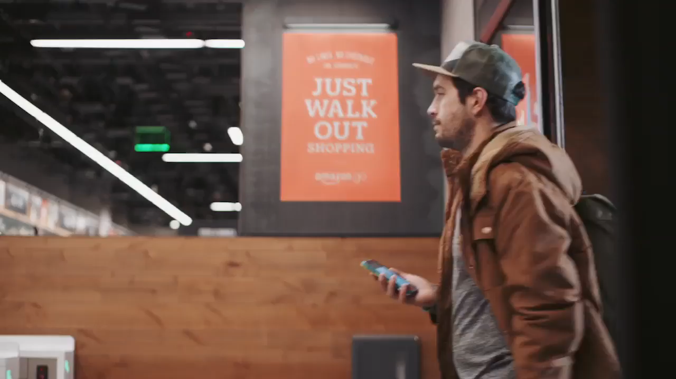
Object recognition (in supermarkets)
Notes:
Amazon Go! https://www.amazon.com/b?ie=UTF8&node=16008589011
Ask – so how does it work?
Think Pair Share!!!

Slide 14
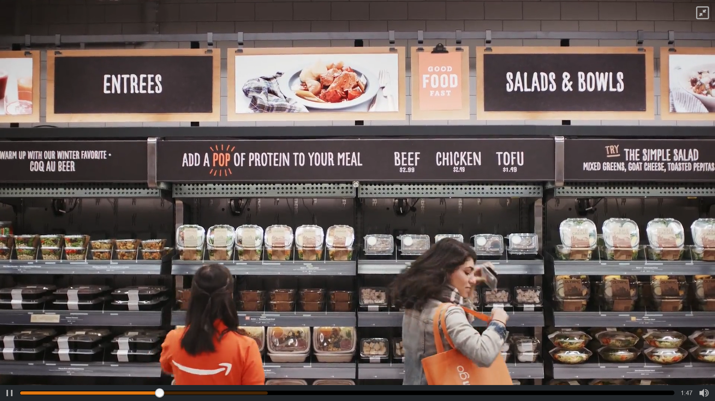
How does it work? Think-Pair-Share

Slide 15

Notes:
Note that you can only walk in if you are an Amazon employee right now.

Slide 16
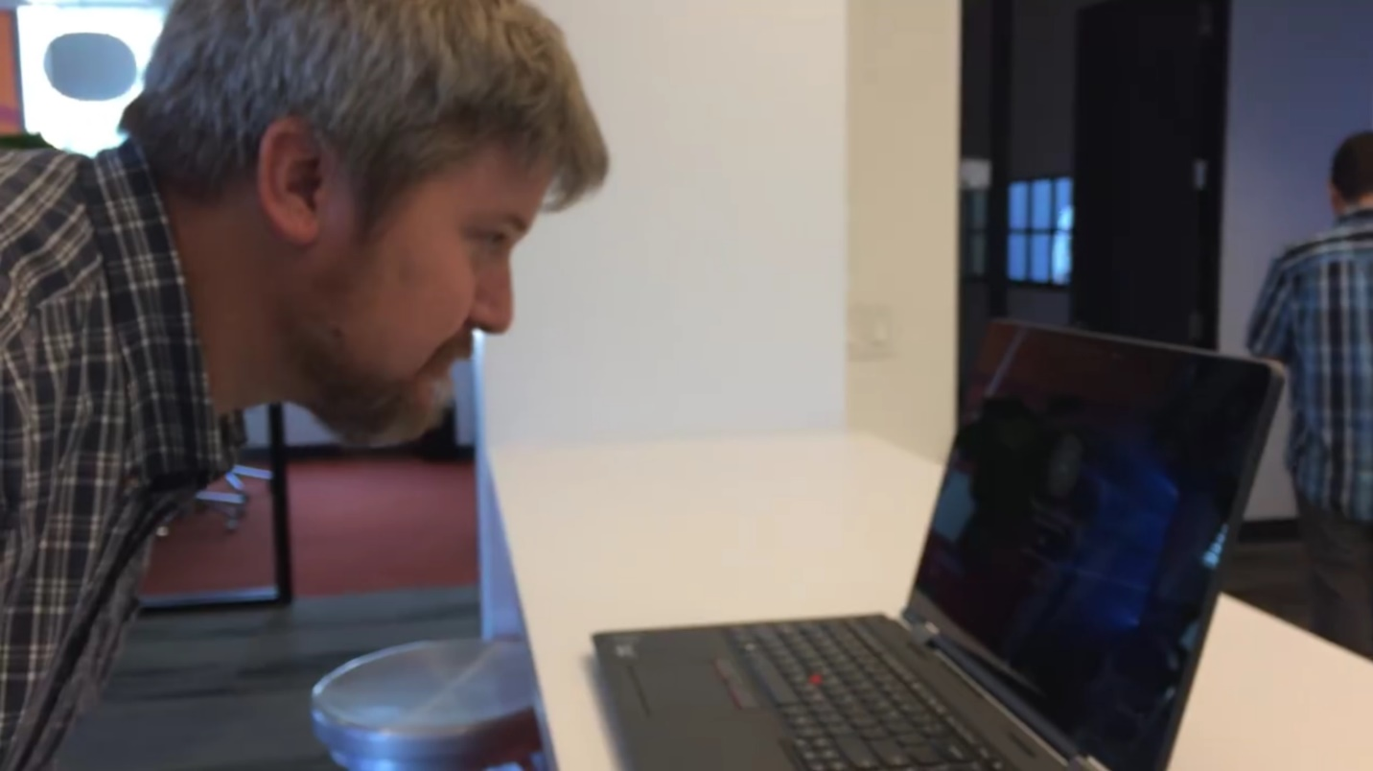
Login without a password…
Notes:
https://www.google.com/url?sa=i&rct=j&q=&esrc=s&source=images&cd=&cad=rja&uact=8&ved=0ahUKEwiJmrLm1d3RAhUJ4yYKHYhOBHkQjRwIBw&url=http%3A%2F%2Fwww.pcworld.com%2Farticle%2F2953512%2Fwindows%2Fhands-on-with-windows-10s-windows-hello-it-just-works.html&bvm=bv.145063293,d.eWE&psig=AFQjCNHypmDl0y-viWICMOJODxtwmz34Bg&ust=1485446513829330
https://www.google.com/url?sa=i&rct=j&q=&esrc=s&source=images&cd=&cad=rja&uact=8&ved=0ahUKEwiDkbnw1d3RAhUB3iYKHXs3DnsQjRwIBw&url=http%3A%2F%2Fwww.pcworld.com%2Farticle%2F2937701%2Fwhy-most-of-us-will-miss-out-on-windows-hello-windows-10s-facial-recognition-feature.html&bvm=bv.145063293,d.eWE&psig=AFQjCNHypmDl0y-viWICMOJODxtwmz34Bg&ust=1485446513829330
https://www.google.com/url?sa=i&rct=j&q=&esrc=s&source=images&cd=&cad=rja&uact=8&ved=0ahUKEwjD0LuA1t3RAhUKRSYKHVTSAgwQjRwIBw&url=http%3A%2F%2Fwww.directtechnologygroup.com%2Fblog%2Fentry%2Ftip-of-the-week-windows-hello-unlocks-your-pc-with-your-face&bvm=bv.145063293,d.eWE&psig=AFQjCNHypmDl0y-viWICMOJODxtwmz34Bg&ust=1485446513829330

Slide 17
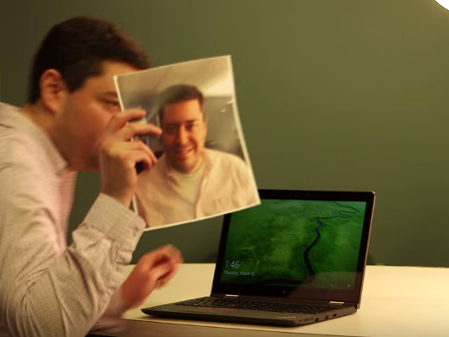
Login without a password…
Notes:
https://www.google.com/url?sa=i&rct=j&q=&esrc=s&source=images&cd=&cad=rja&uact=8&ved=0ahUKEwiJmrLm1d3RAhUJ4yYKHYhOBHkQjRwIBw&url=http%3A%2F%2Fwww.pcworld.com%2Farticle%2F2953512%2Fwindows%2Fhands-on-with-windows-10s-windows-hello-it-just-works.html&bvm=bv.145063293,d.eWE&psig=AFQjCNHypmDl0y-viWICMOJODxtwmz34Bg&ust=1485446513829330
https://www.google.com/url?sa=i&rct=j&q=&esrc=s&source=images&cd=&cad=rja&uact=8&ved=0ahUKEwiDkbnw1d3RAhUB3iYKHXs3DnsQjRwIBw&url=http%3A%2F%2Fwww.pcworld.com%2Farticle%2F2937701%2Fwhy-most-of-us-will-miss-out-on-windows-hello-windows-10s-facial-recognition-feature.html&bvm=bv.145063293,d.eWE&psig=AFQjCNHypmDl0y-viWICMOJODxtwmz34Bg&ust=1485446513829330
https://www.google.com/url?sa=i&rct=j&q=&esrc=s&source=images&cd=&cad=rja&uact=8&ved=0ahUKEwjD0LuA1t3RAhUKRSYKHVTSAgwQjRwIBw&url=http%3A%2F%2Fwww.directtechnologygroup.com%2Fblog%2Fentry%2Ftip-of-the-week-windows-hello-unlocks-your-pc-with-your-face&bvm=bv.145063293,d.eWE&psig=AFQjCNHypmDl0y-viWICMOJODxtwmz34Bg&ust=1485446513829330

Slide 18
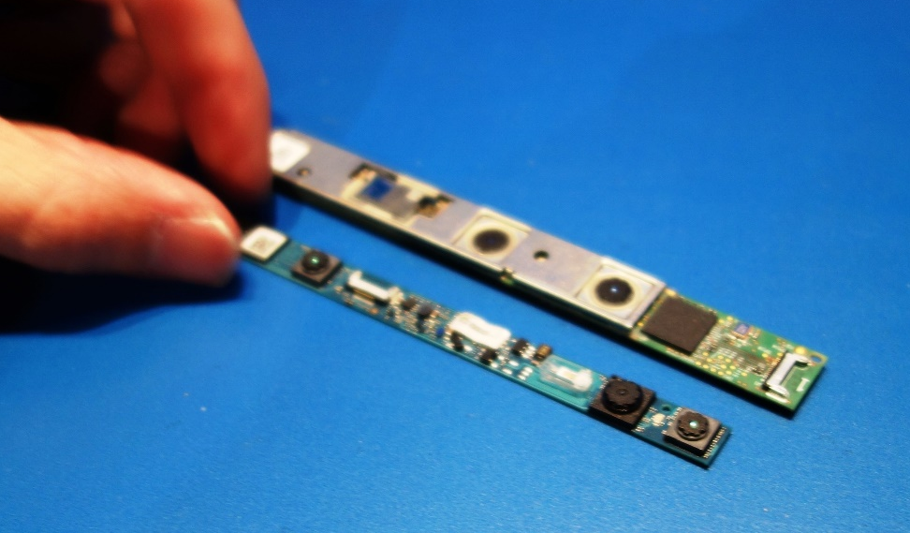
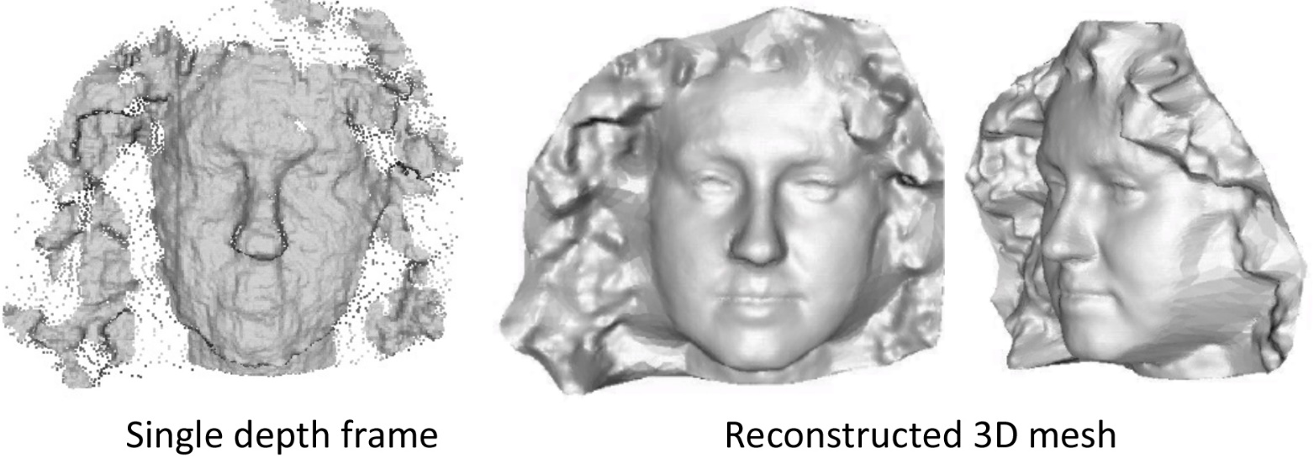
Login without a password…
Liang et al. 2014
Notes:
https://www.google.com/url?sa=i&rct=j&q=&esrc=s&source=images&cd=&cad=rja&uact=8&ved=0ahUKEwiJmrLm1d3RAhUJ4yYKHYhOBHkQjRwIBw&url=http%3A%2F%2Fwww.pcworld.com%2Farticle%2F2953512%2Fwindows%2Fhands-on-with-windows-10s-windows-hello-it-just-works.html&bvm=bv.145063293,d.eWE&psig=AFQjCNHypmDl0y-viWICMOJODxtwmz34Bg&ust=1485446513829330
https://www.google.com/url?sa=i&rct=j&q=&esrc=s&source=images&cd=&cad=rja&uact=8&ved=0ahUKEwiDkbnw1d3RAhUB3iYKHXs3DnsQjRwIBw&url=http%3A%2F%2Fwww.pcworld.com%2Farticle%2F2937701%2Fwhy-most-of-us-will-miss-out-on-windows-hello-windows-10s-facial-recognition-feature.html&bvm=bv.145063293,d.eWE&psig=AFQjCNHypmDl0y-viWICMOJODxtwmz34Bg&ust=1485446513829330
https://www.google.com/url?sa=i&rct=j&q=&esrc=s&source=images&cd=&cad=rja&uact=8&ved=0ahUKEwjD0LuA1t3RAhUKRSYKHVTSAgwQjRwIBw&url=http%3A%2F%2Fwww.directtechnologygroup.com%2Fblog%2Fentry%2Ftip-of-the-week-windows-hello-unlocks-your-pc-with-your-face&bvm=bv.145063293,d.eWE&psig=AFQjCNHypmDl0y-viWICMOJODxtwmz34Bg&ust=1485446513829330
http://grail.cs.washington.edu/projects/liangshu/project3Dv.htm
http://grail.cs.washington.edu/projects/liangshu/images/3dv2014/teaser.jpg

Slide 19
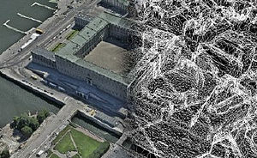
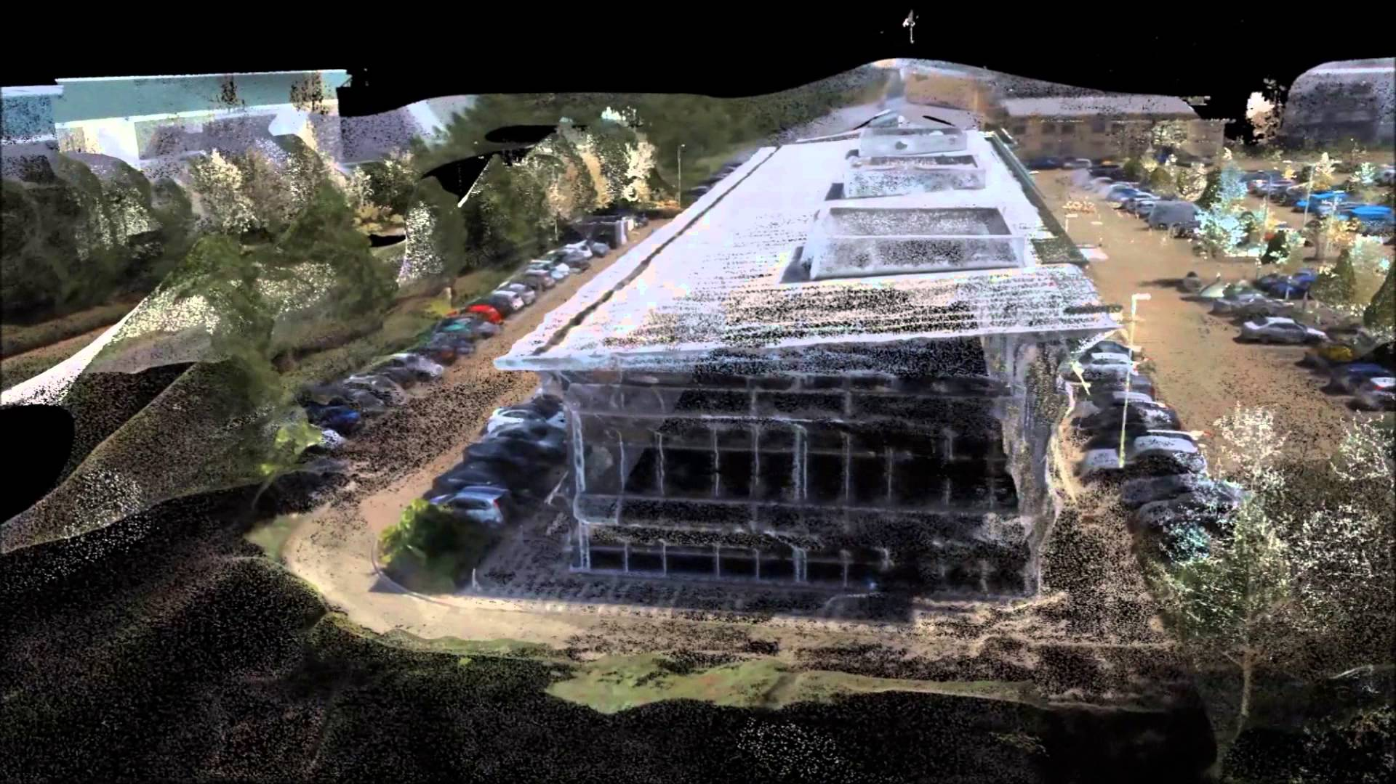
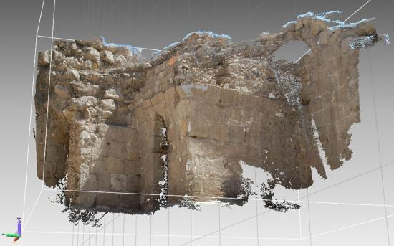
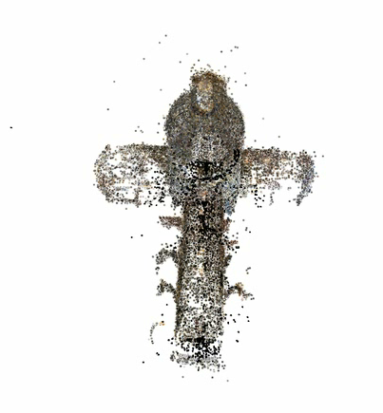
3D from images
Building Rome in a Day: Agarwal et al. 2009
Notes:
https://www.google.com/url?sa=i&rct=j&q=&esrc=s&source=images&cd=&cad=rja&uact=8&ved=0ahUKEwiO3azs1t3RAhVMSyYKHe67Bh8QjRwIBw&url=https%3A%2F%2Fen.wikipedia.org%2Fwiki%2FPhotogrammetry&bvm=bv.145063293,d.eWE&psig=AFQjCNGuhANMLT4cVMPvEM2HZapmFfbS-g&ust=1485446838838556
https://www.google.com/url?sa=i&rct=j&q=&esrc=s&source=images&cd=&cad=rja&uact=8&ved=0ahUKEwjTuuqe193RAhVHwiYKHfSnC-4QjRwIBw&url=http%3A%2F%2Fwww.dicatea.unipr.it%2Fen%2Fresearch%2Fresearch-areas%2Fsurveying-and-photogrammetry&bvm=bv.145063293,d.eWE&psig=AFQjCNGuhANMLT4cVMPvEM2HZapmFfbS-g&ust=1485446838838556
https://www.google.com/url?sa=i&rct=j&q=&esrc=s&source=images&cd=&cad=rja&uact=8&ved=0ahUKEwjryb6s193RAhUCeCYKHWyeDq0QjRwIBw&url=https%3A%2F%2Fwww.youtube.com%2Fwatch%3Fv%3DtSENR_oSEpk&bvm=bv.145063293,d.eWE&psig=AFQjCNGuhANMLT4cVMPvEM2HZapmFfbS-g&ust=1485446838838556

Slide 20
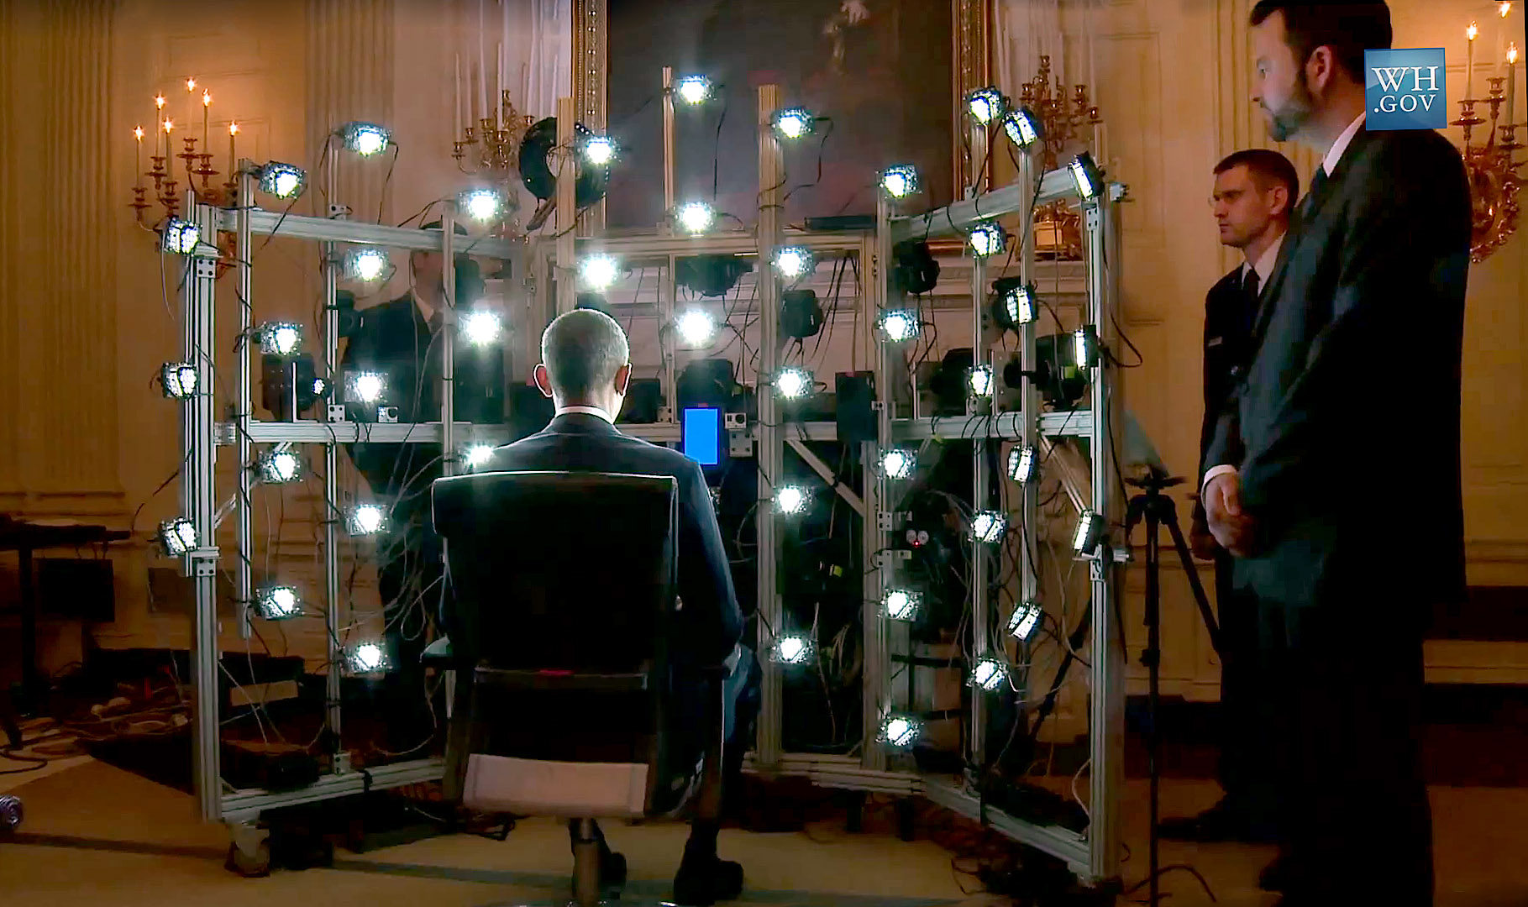
Human shape capture
Notes:
http://gl.ict.usc.edu/Research/presidentialportrait/

Slide 21
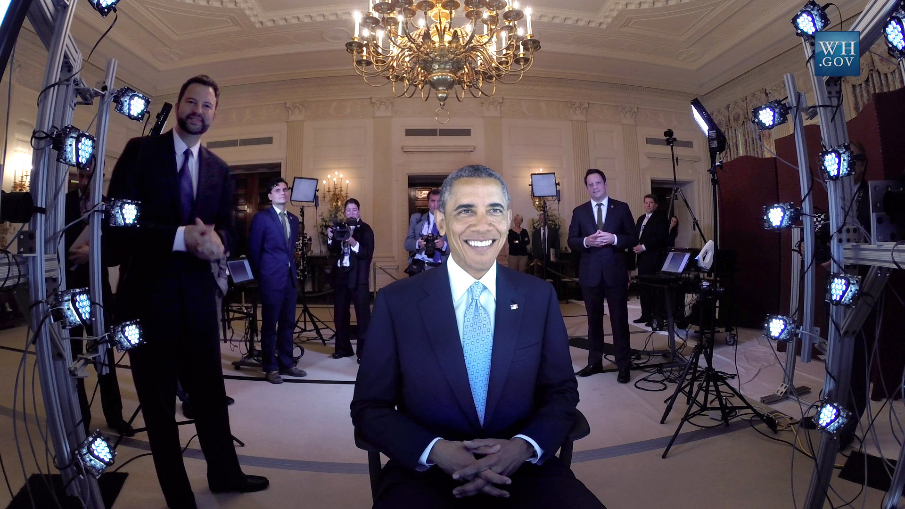
Human shape capture
Notes:
http://gl.ict.usc.edu/Research/presidentialportrait/

Slide 22
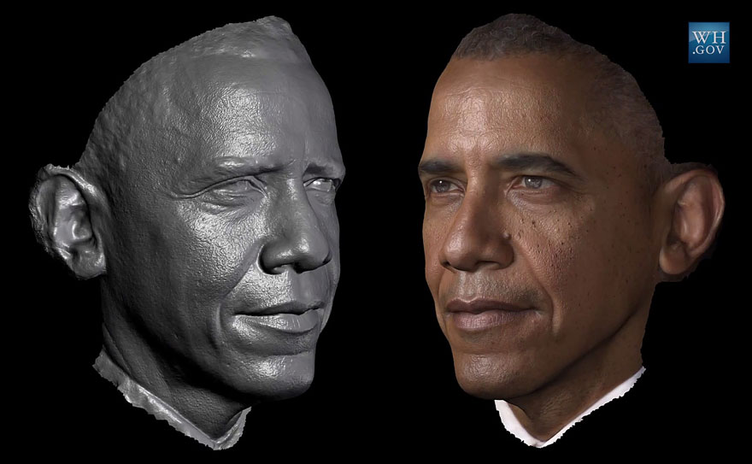
Human shape capture
Notes:
http://gl.ict.usc.edu/Research/presidentialportrait/

Slide 23
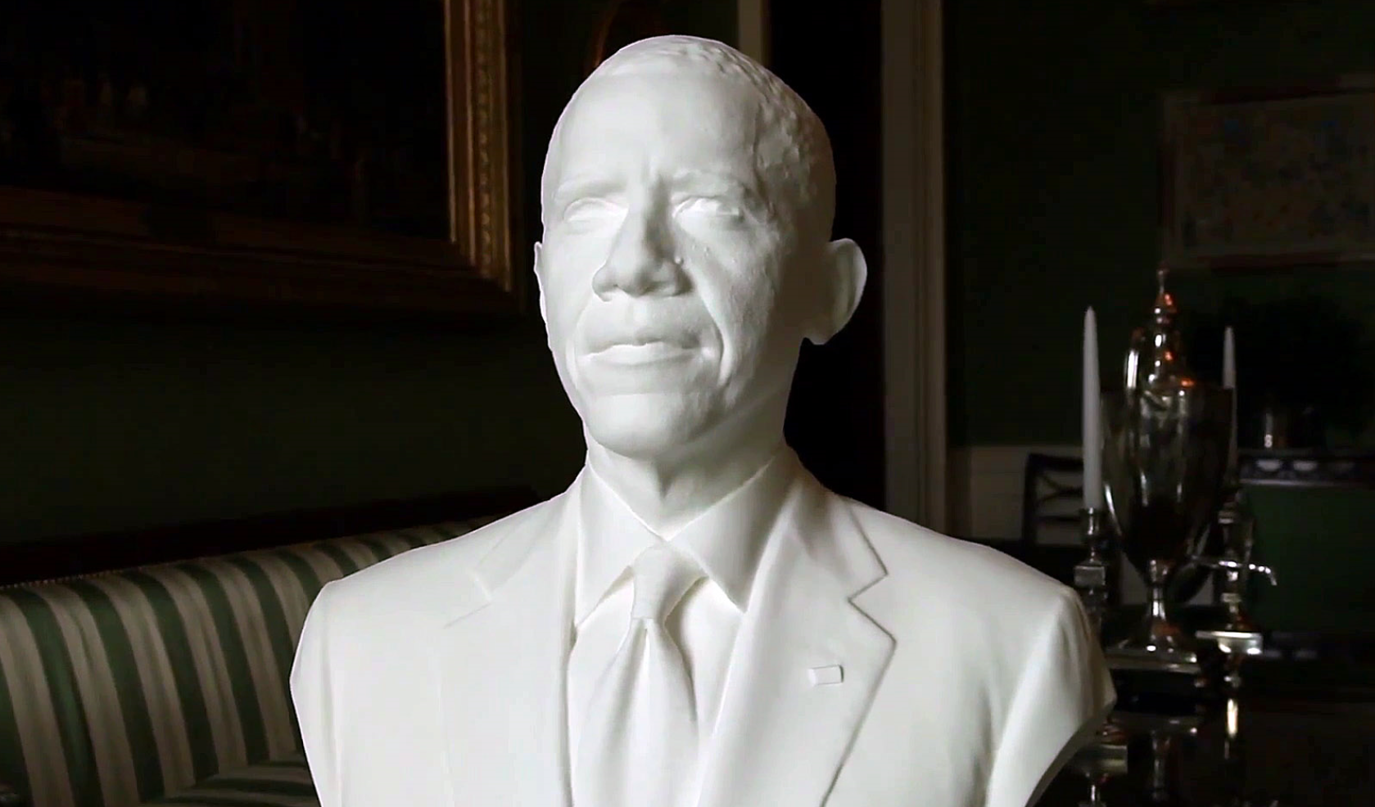
Human shape capture
Notes:
http://gl.ict.usc.edu/Research/presidentialportrait/

Slide 24
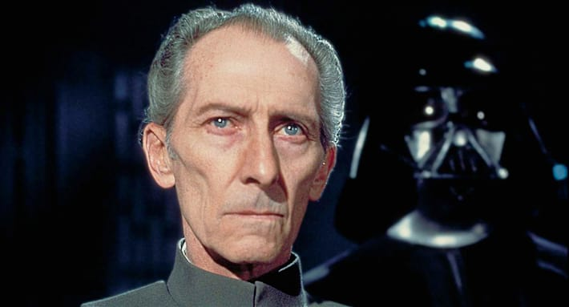
Special effects: shape capture
Star Wars: Rogue One – Peter Cushing / Admiral Tarkin

Slide 25
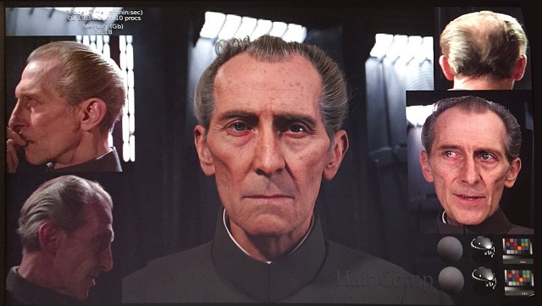
Special effects: shape capture
Notes:
http://cinetropolis.net/tarkin-care-of-business-rogue-ones-digital-peter-cushing/

Slide 26
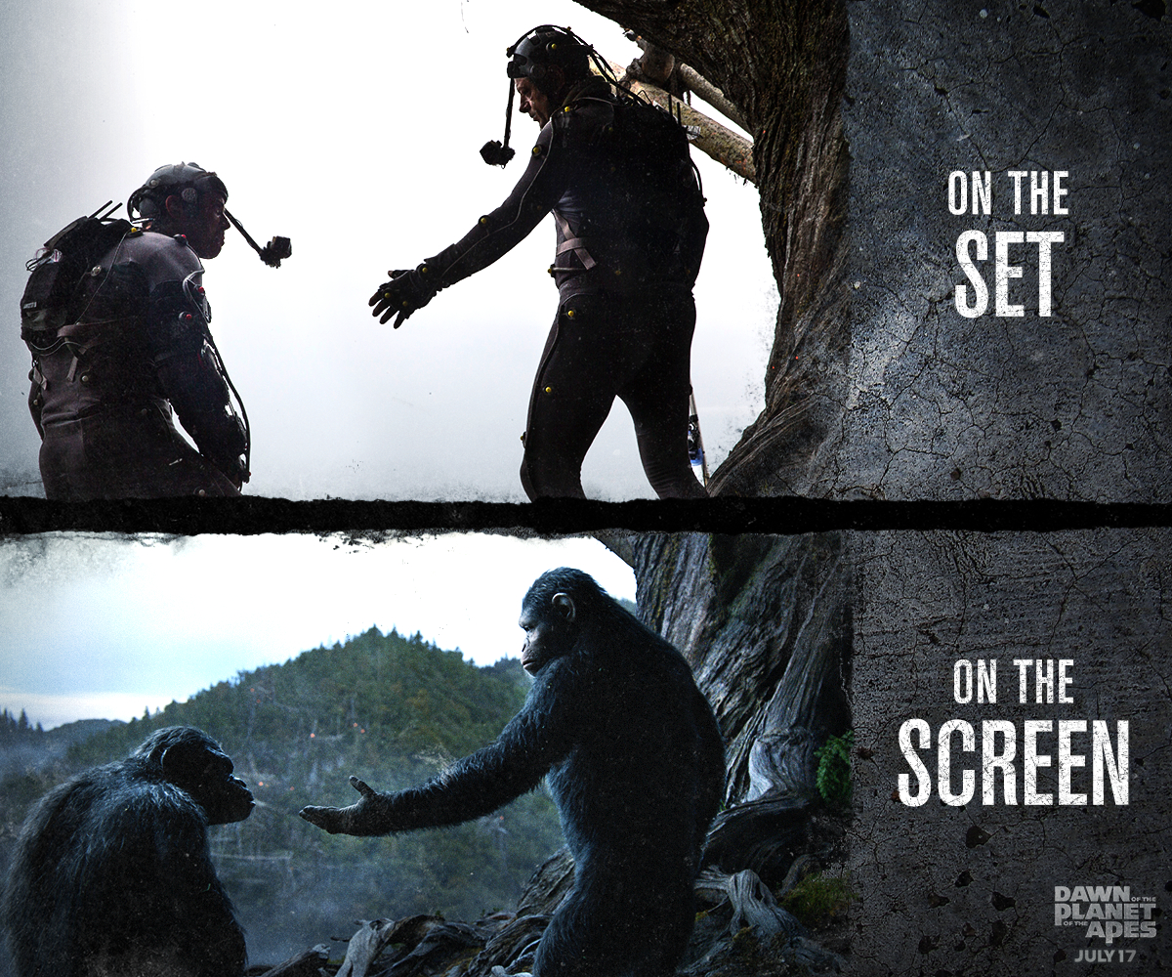
Special effects: motion capture
Notes:
http://www.digitalspy.com/movies/oscars/feature/a584704/why-andy-serkis-deserves-an-oscar-nomination-for-planet-of-the-apes/?zoomable
Weta

Slide 27
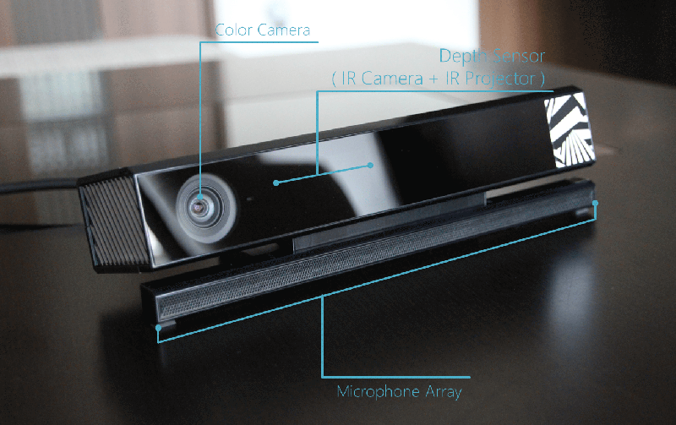
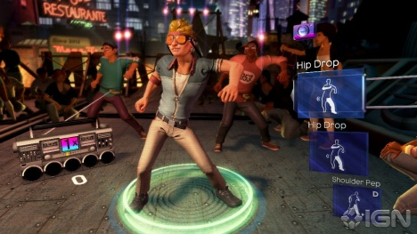
Interactive Games: Kinect
Object Recognition: http://www.youtube.com/watch?feature=iv&v=fQ59dXOo63o
Mario: http://www.youtube.com/watch?v=8CTJL5lUjHg
3D: http://www.youtube.com/watch?v=7QrnwoO1-8A
Robot: http://www.youtube.com/watch?v=w8BmgtMKFbY
JH

Slide 28
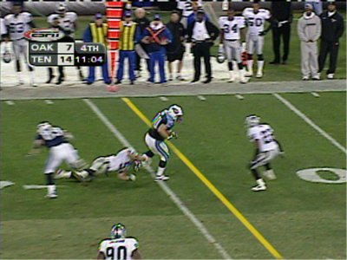
Sports
Sportvision first down line
Nice explanation on www.howstuffworks.com
http://www.sportvision.com/video.html
JH
Notes:
UPDATE: New one from Numair

Slide 29
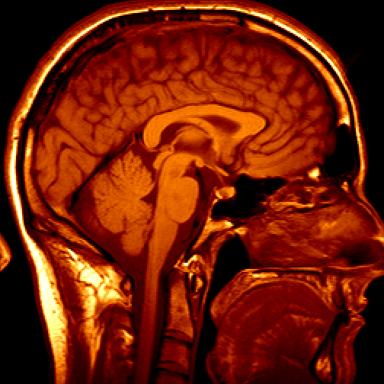
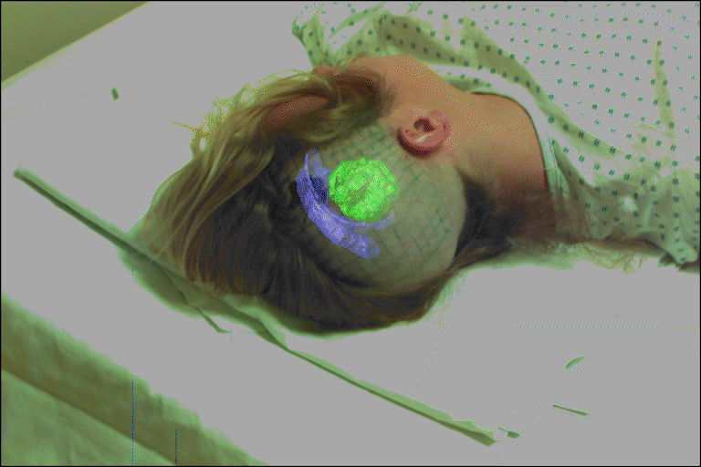
Medical imaging
3D imaging
MRI, CT
Image guided surgery
Grimson et al., MIT
JH

Slide 30
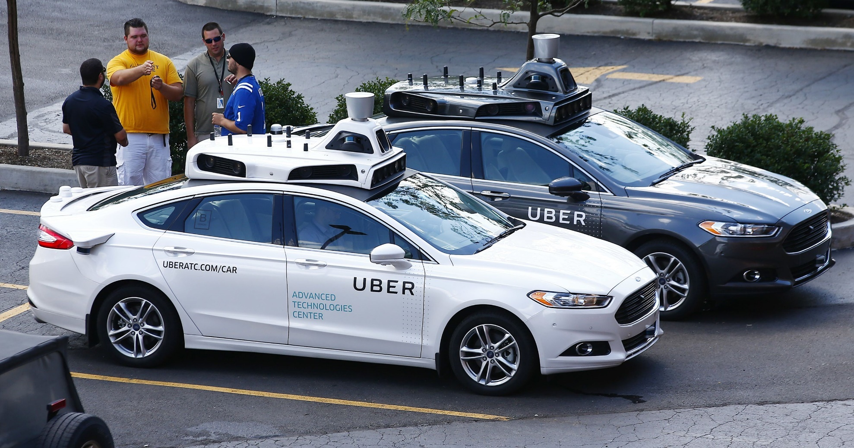
AutoCars - Uber bought CMU’s lab
Notes:
Ask class to count the number of cameras.
http://www.cmu.edu/news/stories/archives/2015/february/uber-partnership.html
http://www.wsj.com/articles/is-uber-a-friend-or-foe-of-carnegie-mellon-in-robotics-1433084582
http://www.freep.com/story/money/cars/ford/2016/08/21/uber--lyft-gm-pittsburgh-autonomous-vehicles-self-driving-autos-equal-profits/88944036/
Oct 9, 2010. "Google Cars Drive Themselves, in Traffic". The New York Times. John Markoff
June 24, 2011. "Nevada state law paves the way for driverless cars". Financial Post. Christine Dobby
Aug 9, 2011, "Human error blamed after Google's driverless car sparks five-vehicle crash". The Star (Toronto)

Slide 31
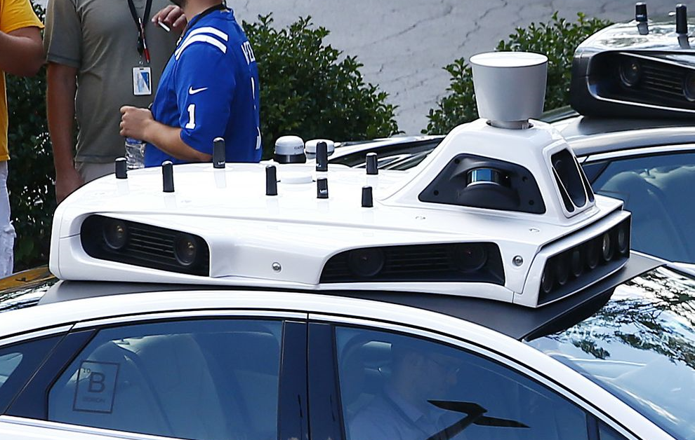
Notes:
Ask class to count the number of cameras.

Slide 32
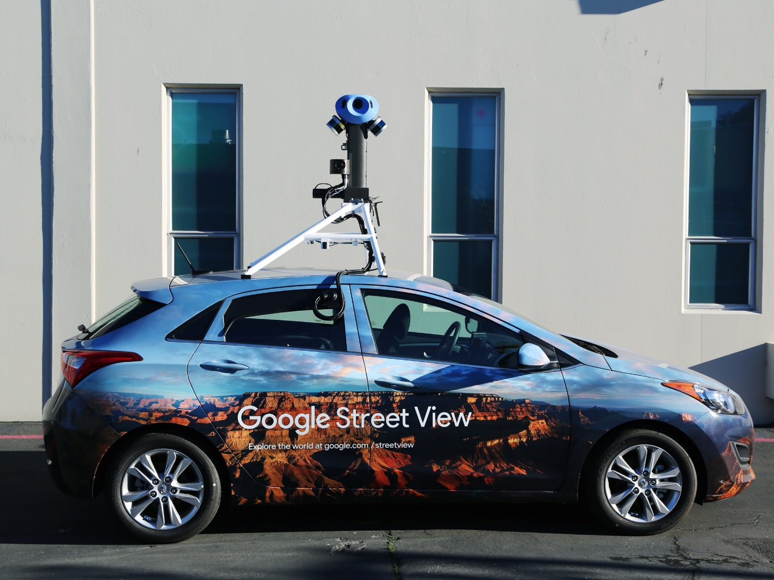

Slide 33
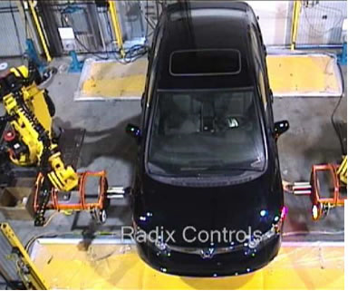
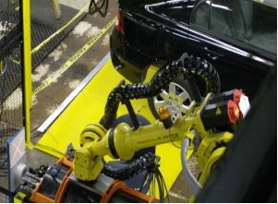
Industrial robots
Vision-guided robots position nut runners on wheels
JH

Slide 34
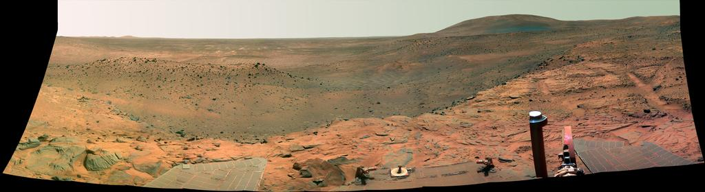
Vision in space
NASA'S Mars Exploration Rover Spirit captured this westward view from atop a low plateau where Spirit spent the closing months of 2007.
Vision systems (JPL) used for several tasks
Panorama stitching
3D terrain modeling
Obstacle detection, position tracking
For more, read “Computer Vision on Mars” by Matthies et al.
JH

Slide 35

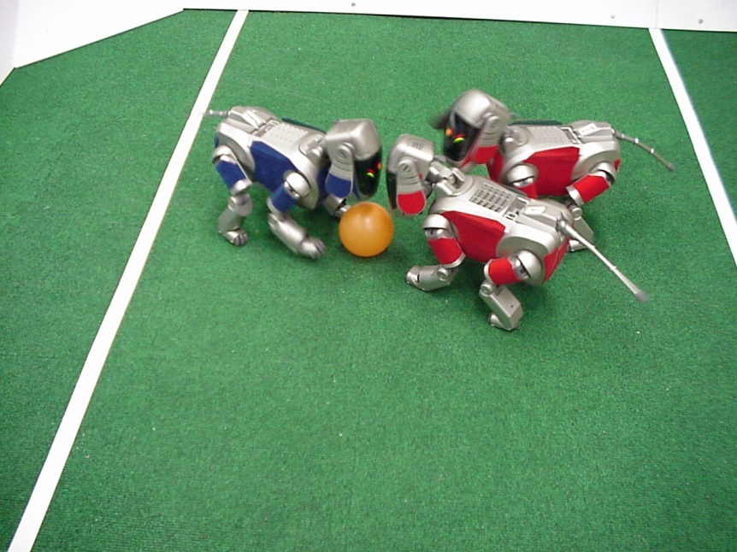
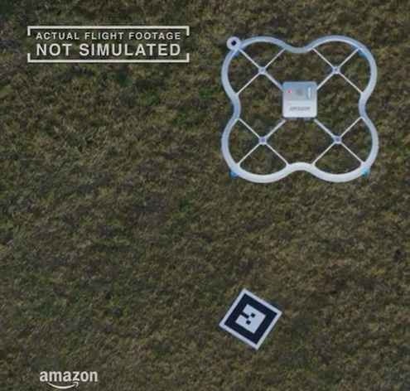
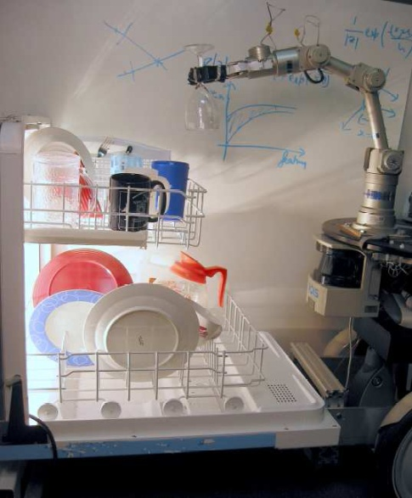

Mobile robots
NASA’s Mars Spirit Rover
http://en.wikipedia.org/wiki/Spirit_rover
http://www.robocup.org/
Saxena et al. 2008
STAIR at Stanford
JH
Notes:
DRONES!
https://www.skydio.com/

Slide 36
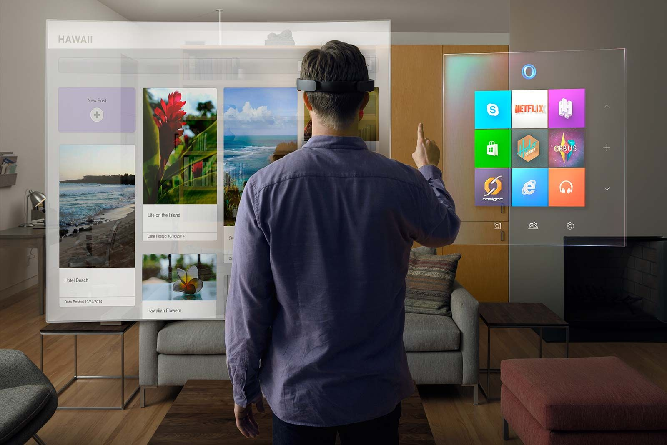
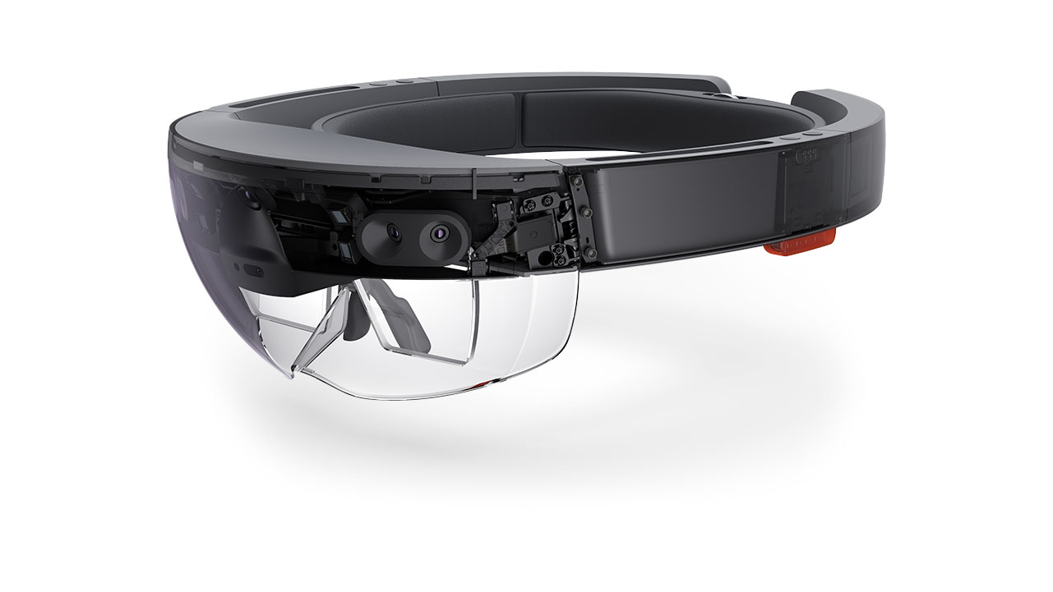
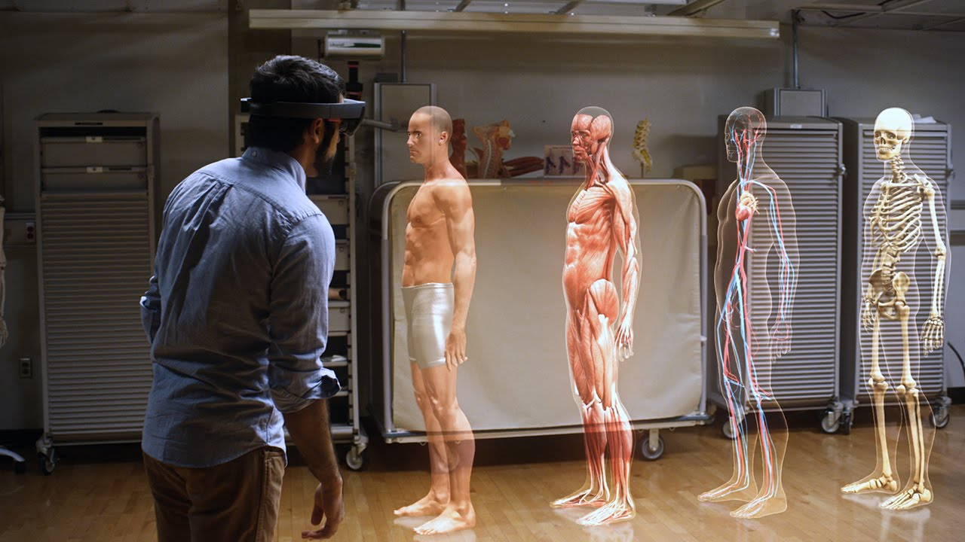
Augmented Reality and Virtual Reality
MS HoloLens, Oculus, Magic Leap,
ARCore / ARKit

Slide 37
Jitendra Malik, UC Berkeley
Three ‘R’s of Computer Vision
“[Further progress in] the classic problems of computational vision:
reconstruction
recognition
(re)organization
[requires us to study the interaction among these processes].”
Notes:
Jitendra Malik – pioneer of computer vision (?)
Tried to coin a ‘Three R’s’ for computer vision. Instead of ‘reading, writing, and arithmetic’….
“For example, in the recent PASCAL benchmark challenge on visual object detection, the average precision for most 3D object categories was under 50%.”

Slide 38
State of the art today?
With enough training data, computer vision nearly matches human vision at most recognition tasks
Deep learning has been an enormous disruption to the field. Many techniques are being “deepified”.
JH

Slide 39
Computer Vision and Nearby Fields
Derogatory summary of computer vision:
“Machine learning applied to visual data.”
JH

Slide 40
Computer Vision and Nearby Fields
Derogatory summary of computer vision:
“Machine learning applied to visual data.”
Question answering
Real world
Digital world
Images, videos,
sensor data…
Images, videos,
interaction
Model of the world
Computer Vision
Computer Graphics
JH

Slide 41
Scope of CSE 152
Computer Vision
Robotics
Machine Learning
Human Computer Interaction
Image Processing Recognition Deep Learning
Geometric Reasoning
Graphics
Medical Imaging
Computational Photography
Neuroscience
Optics
JH

Slide 42
BORING Course DETAILS

Slide 43

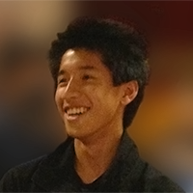

Hao Su
Meng Song
Owen Jow
Zhiran Chen
Tongzhou Mu
We are here to teach you!
Notes:
ALL THE TAs
Octavia Spencer – ‘Hidden Figures’, ‘The Help’, ‘Zootopia’ – Ms. Otterton
Played Dorothy Vaughan in 2016 biopic Hidden Figures, NASA mathematician – Oscar nominated
Spencer Tracy – early Hollywood star; best actor, husband of Katherine Hepburn
Guess Who's Coming to Dinner

Slide 44
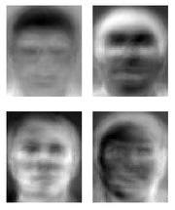
Ridiculously brief history of computer vision
1966: Minsky assigns computer vision as an undergrad summer project
1960’s: interpretation of synthetic worlds
1970’s: some progress on interpreting selected images
1980’s: ANNs come and go; shift toward geometry and increased mathematical rigor
1990’s: face recognition; statistical analysis in vogue
2000’s: broader recognition; large annotated datasets available; video processing starts
2010’s: Deep learning with ConvNets
2027: My very own robot?
Guzman ‘68
Ohta Kanade ‘78
Turk and Pentland ‘91
JH

Slide 45
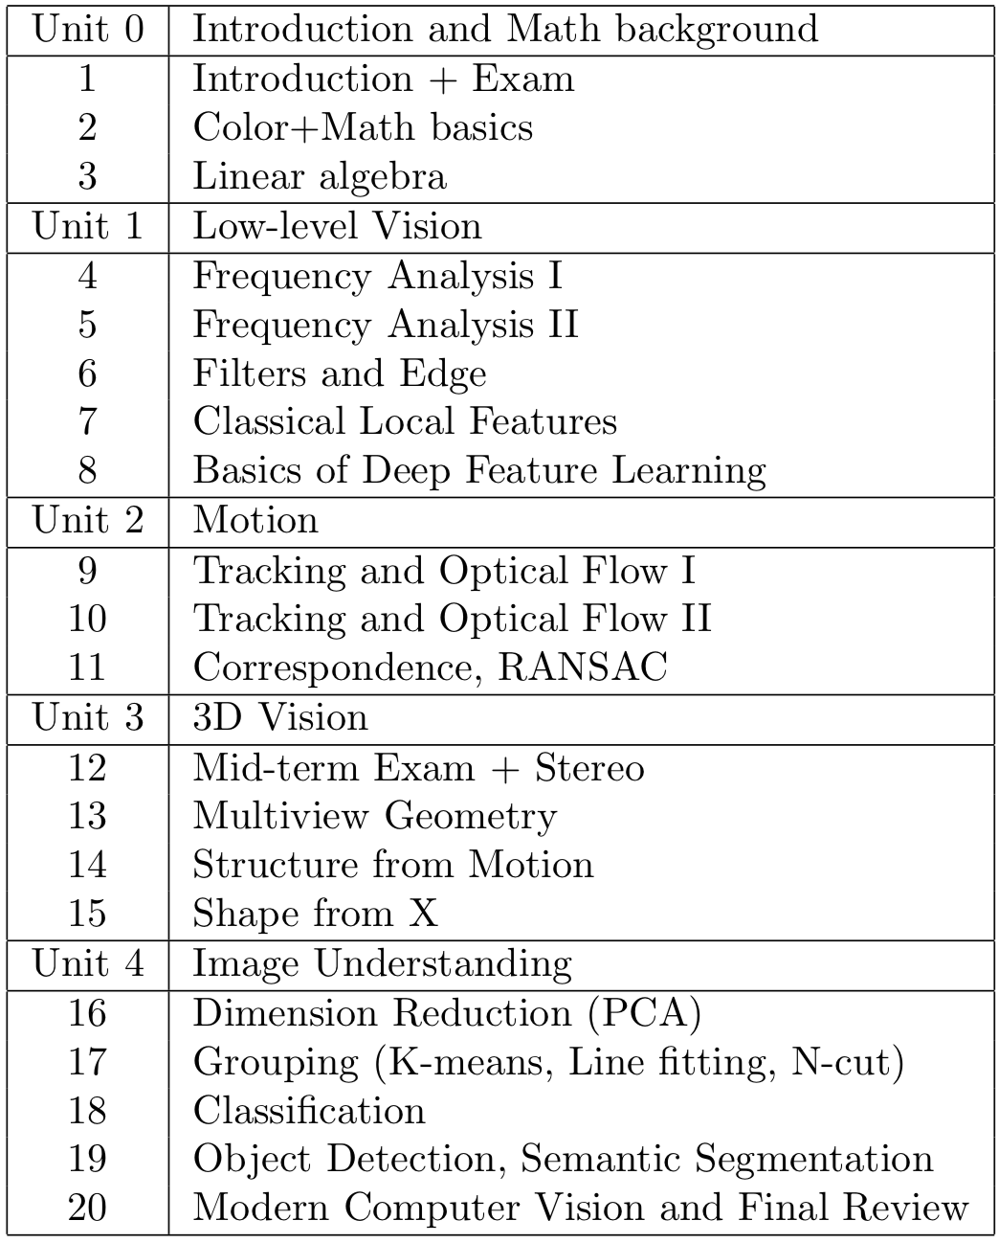
Course Topics

Slide 46
Class Intro
Freshman/Sophomores/Juniors/Seniors/Grads
Linear algebra
Probability?
Graphics course?
Vision/image processing course before?
Machine learning?

Slide 47
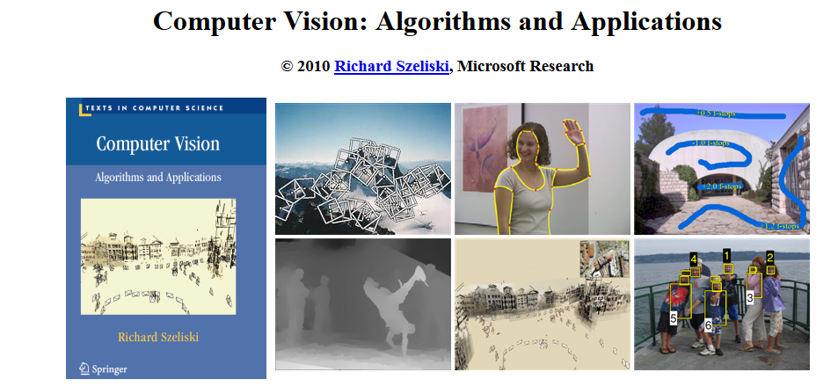
Textbook
http://szeliski.org/Book/
JH

Slide 48

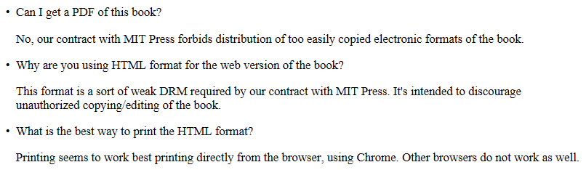
Textbook

Slide 49
Projects / Grading
Homework (4 assignments, 40%)
Mid-term 20%
Final 40%
Our homework is MATLAB based
Notes:
UPDATE

